Slide 1
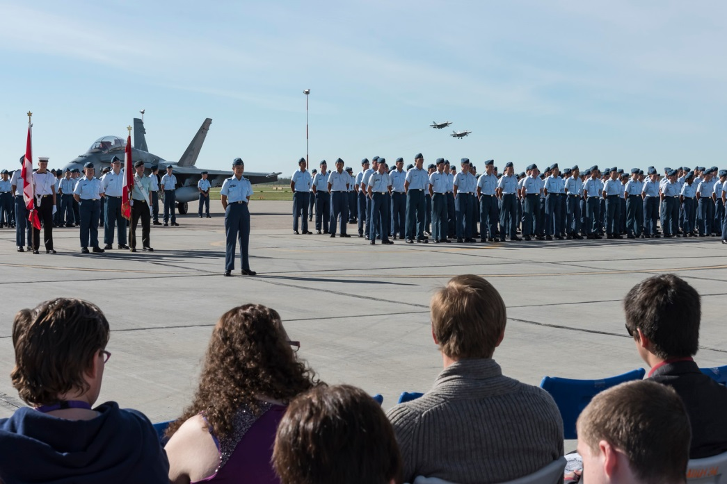
Air Cadet Summer Training
2018

Slide 2
Outline
What is Air Cadet Summer Training?
What courses are available?
Who can attend?
Where is summer training conducted?
Who conducts & supervises the courses?
How do cadets get to and from the centres?
How do cadets apply?
How do cadets get selected?
What is life like at the Cadet Training Centre (CTC)?

Slide 3
Aim Of Summer Training
Provide instruction and opportunities to develop advanced knowledge and skills in specialized activities
To develop instructors and leaders for these activities
To provide further opportunities to employ the general knowledge and skills obtained through the sqn program

Slide 4
Categories of Training
General Training
Basic
Intermediate /Instructor
Advanced Training
2-week course designed to introduce cadets to summer training
3-week courses designed to teach the knowledge & skills in specialized activities
6-week courses designed to develop instructor/leaders in specialized activities
6-week courses designed to advance senior cadets’ leadership and specialized skills

Slide 5
General Training Courses Descriptions
2 Weeks - Cold Lake CTC
The aim of the General Training course is to introduce air cadets to the CTC environment and specialty training qualifications including:
Aviation Ceremonial Leadership
Marksmanship Music
Sports and Fitness CAF Familiarization
Survival

Slide 6
General Training Courses Who can attend?
12 and 13 years of age
Completed Level One at the Sqn
Physically fit and in good health
Recommended by the Sqn Commanding Officer and selected by the RCSU

Slide 7
General Training Courses Course Dates
9 July – 20 July
23 July - 3 Aug
6 Aug - 17 Aug
Specific serials and training centres locations will be allocated to sqns
Course dates do not include travel days. Cadets must be prepared to travel up to 2 days prior and after course dates

Slide 8
Basic Courses (3 weeks)
Basic Drill & Ceremonial
Basic Fitness & Sports
Basic Aviation
Basic Aviation Technology and Aerospace
Basic Survival
Military Band - Basic Musician
Pipe Band - Basic Musician

Slide 9
Basic Courses Who can attend?
13 and 14 years of age
Completed Level two at the Sqn
Physically fit and in good health
Recommended by the Sqns Commanding Officer and selected by the RCSU

Slide 10
Basic Courses Course Dates
3 Weeks
9 July – 27 July
30 July - 17 August
Specific serials and training centres locations will be allocated to corps
Course dates do not include travel days. Cadets must be prepared to travel up to 2 days prior and after course dates.

Slide 11
Basic Courses Descriptions
Basic Fitness and Sports
(Cold Lake CTC)
Become a Fitness & Sports Assistant
Develop a personal fitness routine
Lead warm up and cool down sessions
Assist with the cadet fitness assessment
Assist with recreational / team sports
All Basic Courses are 3 weeks long

Slide 12
Basic Courses Descriptions
Basic Drill and Ceremonial
(Vernon CTC)
Develop peer leadership skills
Lead team-building activities
Command a squadron on parade
Execute rifle drill
All Basic Courses are 3 weeks long

Slide 13
Basic Courses Descriptions
Basic Aviation
(Cold Lake CTC)
Develop skills in the fundamentals of aviation in various areas including principles of flight, meteorology and propulsion.
All Basic Courses are 3 weeks long

Slide 14
Basic Courses Descriptions
Basic Aviation Technology and Aerospace
(Gimli CFTC)
Develop in cadets the fundamentals of aerospace, airport operations and aircraft manufacturing and maintenance.
All Basic Courses are 3 weeks long

Slide 15
Basic Courses Descriptions
Basic Survival
(Cold Lake CTC)
Develop survival skills through practical exercises
Participate in ground search and rescue
Develop skills in ground navigation
All Basic Courses are 3 weeks long

Slide 16
Basic Courses Descriptions
Military Band – Basic Musician
(HMCS QUADRA CTC)
Pipe Band – Basic Musician
(Rocky Mtn CTC)
Develop music skills and music theory knowledge
Drill and ceremonial for military or pipe band.
All Basic Courses are 3 weeks long

Slide 17
Intermediate/Instructor Courses
Drill & Ceremonial Instructor
Fitness & Sports Instructor
Air Rifle Marksmanship Instructor
Survival Instructor
Advanced Aviation
Military Band - Intermediate Musician
Pipe Band - Intermediate Musician

Slide 18
Intermediate/Instructor Courses Who can attend?
14 to 16 years of age
Completed Level Three (3) at the sqn
Be physically fit and in good health
Be recommended by the Sqn Commanding Officer and selected by the RCSU

Slide 19
Intermediate/Instructor Courses Course Dates
6 Weeks
9 July – 17 August
Course dates do not include travel days. Cadets must be prepared to travel up to 2 days prior and after course dates.

Slide 20
Intermediate/Instructor Courses Course Descriptions
Drill & Ceremonial Instructor
(Vernon CTC)
To develop advanced drill and ceremonial related specialist skills and knowledge that will allow the cadet to perform the duties of a specialist instructor and team leader for ceremonial activities
To further develop skills learned in the sqn program

Slide 21
Intermediate/Instructor Courses Course Descriptions
Fitness and Sports Instructor
(Cold Lake CTC)
To develop sports and fitness-related specialist skills and knowledge that will allow them to promote physical fitness
Perform the role of a specialist instructor and a team leader for fitness and sports activities conducted at the sqn, regionally directed activities and/or as a staff cadet at a CTC

Slide 22
Intermediate/Instructor Courses Course Descriptions
Air Rifle Marksmanship Instructor
(Vernon CTC or Whitehorse CTC)
To develop individual air rifle marksmanship and summer biathlon specialty skills
To developing the cadet’s leadership and instructional techniques skills preparing the cadet to support these activities at the sqn, CTC or regionally and/or nationally directed activities.

Slide 23
Intermediate/Instructor Courses Course Descriptions
Survival Instructor
(Cold Lake CTC)
To develop a specialist with the skills and subject matter knowledge required to be an instructor and team leader for aircrew survival activities within the Air cadet program.

Slide 24
Intermediate/Instructor Courses Course Descriptions
Advanced Aviation
(Comox CFTC)
To develop a specialist with the skills and subject matter knowledge required to be an instructor and team leader for aviation activities within the Air cadet program
Note: 3 weeks in duration

Slide 25
Intermediate/Instructor Courses Course Descriptions
Military Band - Intermediate Musician (Albert Head CTC)
Pipe Band - Intermediate Musician
(Rocky Mtn CTC)
To further develop music skills and music theory knowledge.
Prerequisite: Musician Proficiency Level Basic

Slide 26
Advanced Training
Military Band – Advanced Musician
Pipe Band – Advanced Musician

Slide 27
Advanced Training Who can attend?
Completed Level 4 at the sqn
Be physically fit and in good health
Be recommended by the Sqn Commanding Officer and selected by the RCSU

Slide 28
Advanced Training Course Dates
6 Weeks
9 July – 17 August
Course dates do not include travel days. Cadets must be prepared to travel up to 2 days prior and after course dates.

Slide 29
Advanced Training Descriptions
Military Band – Advanced Musician
(HMCS QUADRA CTC)
To gain the knowledge and skills required of a band instructor
Provide an opportunity to develop instructional skill and style
Enhance skills playing and leading in a corps band
Prerequisite: Musician Proficiency Level 2

Slide 30
Advanced Training Descriptions
Pipe Band - Advanced Musician
(Rocky Mtn CTC)
To gain the knowledge and skills required of a band instructor
Provide an opportunity to develop instructional skill and style
Enhance skills playing and leading in a corps band
Prerequisite: Musician Proficiency Level 2

Slide 31
National Courses
Advanced Aviation – Airport Operations
Advanced Aviation – Aircraft Maintenance
Advanced Aerospace
Glider Pilot Scholarship
Power Pilot Scholarship
International Air Cadet Exchange

Slide 32
National Courses Who can attend?
Level 3 Qualified
Advanced Aviation – Airport Operations, Aircraft Maintenance, Advanced Aerospace and Glider Pilot Scholarship
Level 4 Qualified
Power Pilot Scholarship
Level 5 Qualified
International Air Cadet Exchange
Be recommended by the Sqn Commanding Officer and selected by the RCSU

Slide 33
National Courses Selection
Each provincial/territorial Air Cadet League conducts a file review and interviews (Selection Boards)
Cadets must submit an application including a narrative, school report and other documents based on the course applying for
Gliding and Power applicants must pass the CAF Flying Qualifying Exam and be in possession of a valid Medical Category 3 Certificate from Transport Canada

Slide 34
National Courses Course Dates
IACE
TBD
PPS
1 July – 17 August
9 July - 17August
Course dates do not include travel days. Cadets must be prepared to travel up to 2 days prior and after course dates.

Slide 35
National Courses Descriptions
Advanced Aviation – Airport Operations
(Canadore College, North Bay, ON)
Introduces cadets to programming specific to airport operations through practical, hands-on learning modules that will reinforce theoretical notions.

Slide 36
National Courses Descriptions
Advanced Aviation – Aircraft Maintenance
(Canadore College, North Bay, ON)
Introduce cadets to aircraft construction and maintenance.

Slide 37
National Courses Descriptions
Advanced Aerospace
(St Jean CFTC)
Develop a specialist with the skills and subject matter knowledge required to be an instructor and team leader for aerospace activities within the Air cadet program

Slide 38
National Courses Descriptions
Glider Pilot Scholarship
(Gimli CFTC)
Develop, train and obtain a glider pilots license.

Slide 39
National Courses Descriptions
Power Pilot Scholarship
(Various)
Develop, train and obtain a power pilots license.

Slide 40
Where is summer training conducted?
Cold Lake CTC
(Cold Lake, AB)
Located on CFB Cold Lake in Alberta, Approximately 400 kms NE of Edmonton
Cadets are housed in 2, 4 or 16 (survival) person rooms in permanent barracks with all bedding provided
Additional facilities include: canteen, cadet banking, medical inspection room

Slide 41
Where is summer training conducted?
Rocky Mountain CTC
(Ghost River, AB)
Located in the Rocky Mountain Forest Reserve 100 Km NW of Calgary and 45 km NW of Cochrane
All cadets are housed in eight person rooms in permanent barracks with all bedding provided
Additional facilities include: canteen, cadet banking, medical inspection room, internet access

Slide 42
Where is summer training conducted?
Vernon CTC
(Vernon, BC)
Located in the interior of BC on the north end of the Okanagan valley in the city of Vernon.
Most cadets are housed dormitory style in permanent barracks with all bedding provided. Some cadets will be housed in 6 man tents (CF Modular) with electricity.
Additional facilities include: games room, canteen, internet cafe, cadet bank, church, medical inspection room

Slide 43
Where is summer training conducted?
Whitehorse CTC
(Whitehorse, YK)
Located at Boyle Barracks 20 km south of Whitehorse
Most cadets are housed dormitory style in permanent barracks with all bedding provided. Some cadets will be housed in six person modular (CF Modular) with electricity
Additional facilities include: canteen, cadet bank, medical inspection room

Slide 44
Where is summer training conducted?
HMCS QUADRA CTC
(Comox, BC)
Located north of Nanaimo on the east coast of Vancouver Island. The training centre is located on spit near the town of Comox.
Cadets are housed dormitory style in permanent barracks with all bedding provided.
Additional facilities include: games room / canteen, cadet bank, medical inspection room (MIR)

Slide 45
Who conducts and supervises the courses?
Members of the Cadet Organisation and Administration Service (COATS) including Cadet Instructor Cadre Officers, and Civilian Instructors, Regular Force, Primary Reserve members, and civilian contractors
Senior cadets are also employed as staff cadets to assist with supervision and instruction
The ratio of adult supervisor to cadet is approximately 1:10

Slide 46
Cadets: What will life be like?
Close quarters with cadets from all over Canada
Meals in mess halls
Busy training days
“Down time” in the evenings
Home sickness / calling home
Personal hygiene (care for yourself)
Laundry and uniform care
Make great friendships
Learn fantastic skills
Receive training bonus (approx $60/week)

Slide 47
Parents: What to expect?
May receive anguished calls or texts from your home sick cadet
Best advice: TRUST the staff at the CTC to take good care of your cadet – do not try to interfere
Leave Passes / visitation is granted at specific times only so as not to interfere with training – CALL AHEAD
If you’ve been doing your cadet’s laundry and ironing – STOP! They must do it themselves at the CTC
Management of their training bonus/finances

Slide 48
How are cadets selected?
Cadets submit their list of choices to the sqn staff
The sqn staff must create applications in Fortress (a digital database)
Cadets and parents need to be aware that medical/participation limitations (including allergies and asthma) may prevent or limit selection for CTC courses
Incomplete personal or medical information in Fortress can also prevent or delay selection

Slide 49
How are cadets selected?
The sqn CO reviews each cadet’s application and prioritizes them based on attendance, merit and level of participation in sqn activities and other factors
Cadets are course loaded by RCSU using the priority list as a guideline, however, there are limited positions available (positions are created at Cadet Training Centres for 30% of cadets enrolled)
Sqns are notified of cadet selections by 1 April
Not all cadets will get the opportunity to attend summer training.
Selection is based on performance at the Sqn.

Slide 50
Completing the Application
Every year cadets are not selected because of incomplete information in Fortress. Please read the application thoroughly. Here are some specific items to pay particular attention to:
Contact Information
Ensure that your current phone numbers and email addresses are on file with the sqn by completing the annual validation form

Slide 51
Completing the Application
Additional Information
If you do not know the information required check with the Sqn staff. They can provide the information available in Fortress or your personal folder.
Medical Health Changes
If your medical information has changed you will need to fill out a Detailed Health Questionnaire. The medical information must be the most current available.

Slide 52
Application due date?
Sqn Deadline: _______
Sqn will set their own deadline prior to the RCSU deadline in order to allow time for the staff to prioritize and enter the applications into Fortress
RCSU Deadline: 1 Feb 2018
Any applications entered into Fortress after this date will still be considered, however, they will be placed at the bottom of the priority list

Slide 53
What happens when I have been selected?
Sqn staff will notify you of your selection and present you with an “Offer of Participation”
Both the cadet and the parent must sign the offer
The Sqn staff will keep a copy of the Offer, and the cadet must bring a copy to the CTC

Slide 54
What happens when I have been selected?
Sqn staff will submit your answer (accept or decline) into Fortress
Travel Orders and Joining Instructions will be emailed directly to the email address on file in Fortress. Please ensure your correct email address is provided to the sqn

Slide 55
Completing the Offer of Participation Form
It is extremely important that you review all the information on this form to make sure it is correct. Make any corrections necessary.
Ensure that all other sections of the form are completed including:
Leave pass restrictions
Alternate Family or Friend Contact
Cadet signature
Parent Signature

Slide 56
How do cadets get to and from the training centres?
All transportation is organized and paid for by DND
Cadets may travel by bus, commercial air, or DND air
Cadets are escorted or met on all legs of their journey when travelling in large groups. For smaller groups adult escorts will be based on location and duration
If parents request special transportation arrangements, (or RTU), they may be financially responsible
The dates listed are course dates and cadets may travel up to two days prior and following the course dates

Slide 57
Contacts
Please direct any questions to our Sqn’ contact
INSERT YOUR CORPS CONTACT INFORMATION

Slide 58
?
Questions?
Questions?
Questions?
Questions?
?

