Slide 1
Royal Canadian Air Cadets
Air Cadet League of Canada – Saskatchewan Provincial Committee (SKACL)
To Learn • To Serve • To Advance
www.SKACL.ca

Slide 2
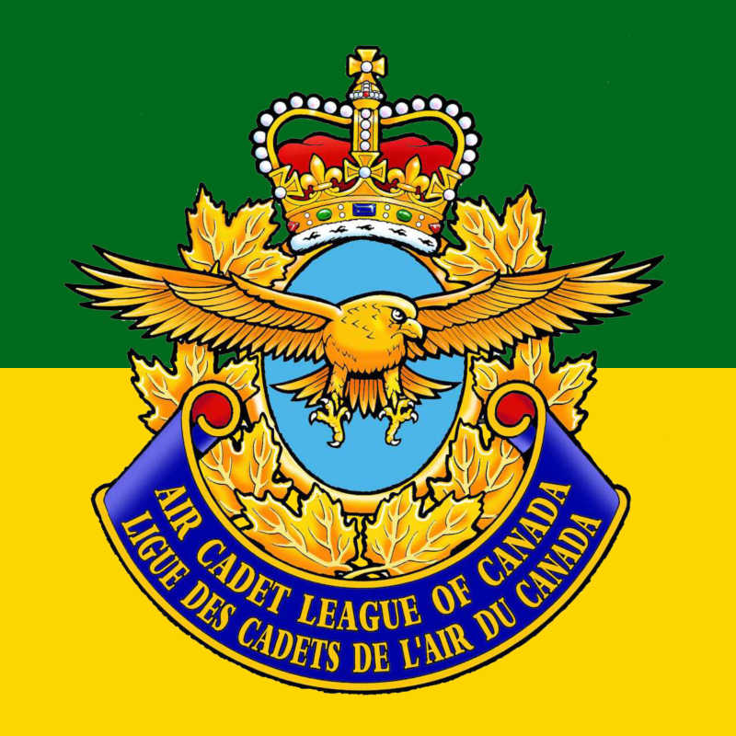
Air Cadet League of Saskatchewan Cadet Recruitment Video
https://www.youtube.com/watch?v=R8S9azrEyJs

Slide 3
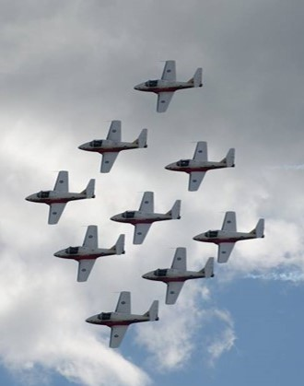
Agenda
History
Present
Department of National Defense (DND) and Air Cadet League (ACL)
What Air Cadets do
Dress and Deportment
Ranks
Cadet
Officer
Squadron Organizational Structure
Summer Courses
Famous Cadets

Slide 4
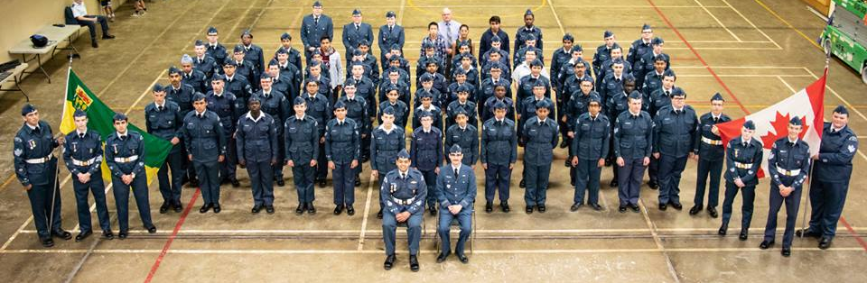
What are Air Cadets?
Canadian national youth program for young individuals aged 12 to 18
Two groups fund and support this program:
Department of National Defense
Air Cadet League of Canada (and provincial committees)
Cadet program (Air, Sea, Army) forms the largest federally funded youth program in Canada
Cadets are not members of the military and are not obliged to join the Canadian Forces.

Slide 5
Aims
Develop in youth the attributes of good citizenship and leadership
1
Promote physical fitness
2
Stimulate the interest of youth in the air element of the Canadian Forces
3

Slide 6
History
1941 – Air Cadet league and program formed to train pilots for WWII
1942 – 135 squadrons with 10,000 cadets
1943 – 315 squadrons with 23,000 cadets
1944 – 374 squadrons with over 29,000 cadets, 1750 officers/instructors, 2,000 civilians
1946 (post war) - Air Cadet League of Canada and Royal Canadian Air Force expand program (citizenship, leadership, physical fitness, flying scholarships and summer camp opportunities established)
1968 – new partnership with Canadian Armed Forces (replacing Air Force)
1990s – total of 1 million young Canadians have participated in the Air Cadet training program

Slide 7
Present
Over 26,000 active Air Cadets in Canada
Over 50,000 people contribute to Air Cadet movement today
453 active squadrons in Canada
34 squadrons in Saskatchewan
The purpose of this program has evolved to focus on citizenship, leadership, physical fitness, general aviation and stimulating an interest in the activities of the Canadian Forces.

Slide 8
Air Cadet League & Department of National Defense

Slide 9
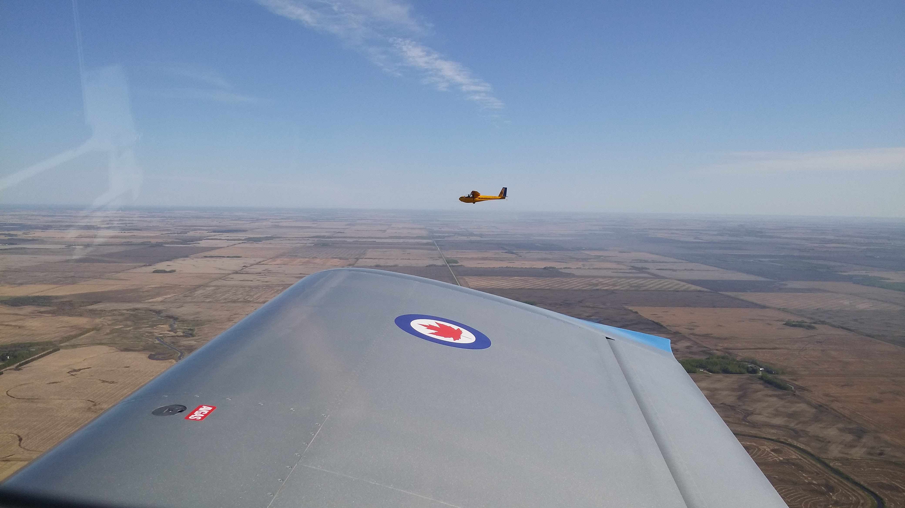
Air Cadet League (ACL)
Civilian, non-profit, community-based and volunteer-led organization that in collaboration with the Department of National Defence and other partners, is dedicated to supporting the objectives of the Royal Canadian Air Cadet program
The purposes of the League are to advance the education of Air Cadets, fundraise and provide funding to squadrons, and to promote an interest in the world of Aviation

Slide 10
ACL Levels
National
Administrative headquarters, policies, national scholarships, insurance, gliding/flying
Provincial
Saskatchewan Provincial Committee
Own all Air Cadet gliders, tow aircraft, and equipment for gliding centres
Some responsibilities include: Effective Speaking program, Curling, board interviews for national summer courses, Camp Saskadet, registration/screening of volunteers, fundraising, and recruiting officers/cadets
Local
Squadron Sponsoring Committee (SSC) at each squadron – composed of parent volunteers (parents are encouraged to join)
Provide training facilities, recruit officers/cadets, fundraising, financial assistance and transportation for some activities.
Squadron Sponsor

Slide 11
Department of National Defense (DND)
Officers in the squadron are Canadian Forces members (CIC - Cadet Instructor Cadre) – parents are eligible to join
Training, supervision, and administration of air cadet squadrons
Some major resources provided include:
Uniform
Transportation, funding, and supplies for mandatory activities
Summer training centres and courses
Training materials

Slide 12
What Air Cadets do
Cadets run during the academic year: September – June
summer courses available
Parade Night – weekly training program that runs once a week; consists of parade, classes, tours, sports, and other fun activities
Throughout the year, squadrons host activities such as special trips, survival weekends (FTX), community support, competitions, social events, and fundraising activities for the squadron
Cadets will move up in rank based on their merit, commitment, ability to take on greater roles and responsibilities, and age and years of experience in Cadets
Air Cadets are also given the opportunity to participate in various optional activities such as Effective Speaking, Marksmanship, Biathlon, Curling, Drill & Flag Party, and Band & Music
To fund many of the cadet program activities, cadets and parents of cadets are expected to participate in and contribute to fund raising as required and, when possible, parents and other interested individuals are encouraged to volunteer their services to contribute to the success of the Air Cadet Program

Slide 13
What to wear
All Cadets will be given a uniform free-of-charge
Classes on proper uniform wear, maintenance, and standards will be given
Uniform parts can be exchanged if they don’t fit properly, and must be returned if no longer needed (including leaving cadet program)
What to wear before uniform is given:
White long-sleeve dress shirt
Black dress pant
Black dress shoes or equivalent

Slide 14
Hair Standards
Hair must be conservative color and style
First year cadets will have in-depth classes about proper uniform and dress standards

Slide 15
Uniform standards, care, badge placement, etc. can be found on www.SKACL.ca

Slide 16
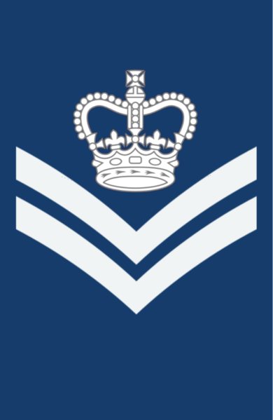
Cadet Ranks (1)
Air Cadet (AC)
Leading Air Cadet (LAC)
Corporal (Cpl)
Flight Corporal (FCpl)

Slide 17
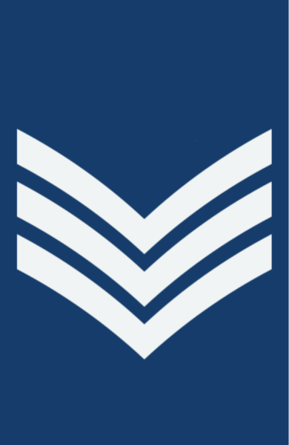
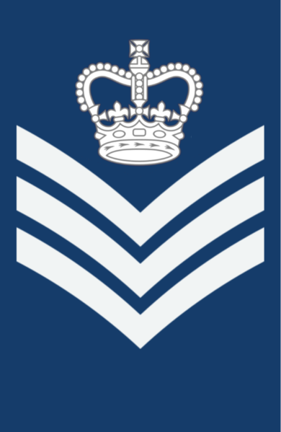
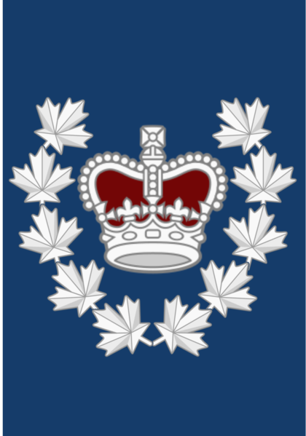
Cadet Ranks (2)
Sergeant (Sgt)
Flight Sergeant (FSgt)
Warrant Officer
2nd Class (WO2)
Warrant Officer
1st Class (WO1)

Slide 18
Officer Ranks (Present in most squadrons)
Officer Cadet
(OCdt)
2nd Lieutenant
(2Lt)
Lieutenant
(Lt)
Captain
(Capt)
Major
(Maj)

Slide 19
Squadron Organizational Structure
Commanding Officer
Training Officer
Admin Officer
Supply Officer
Other Officers
Cadet Commander - Warrant Officer 1st Class (WO1)
Warrant Officer 2nd Class (WO2)
Flight Sergeants (FSgt)
All Other Cadets (AC, LAC, CPL, FCPL, SGT)

Slide 20
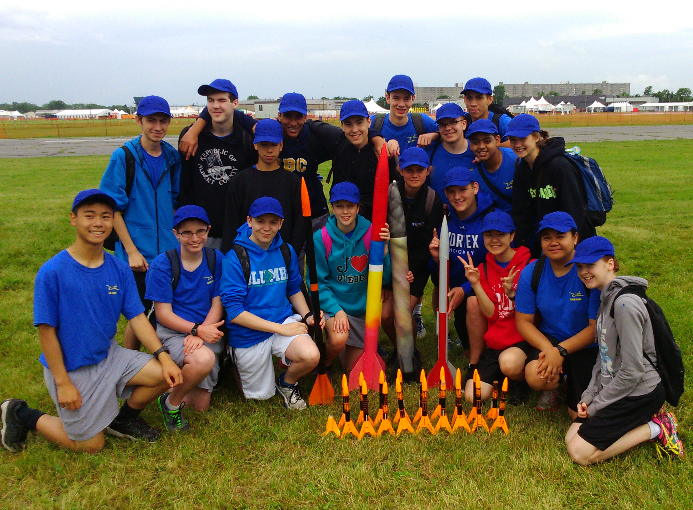
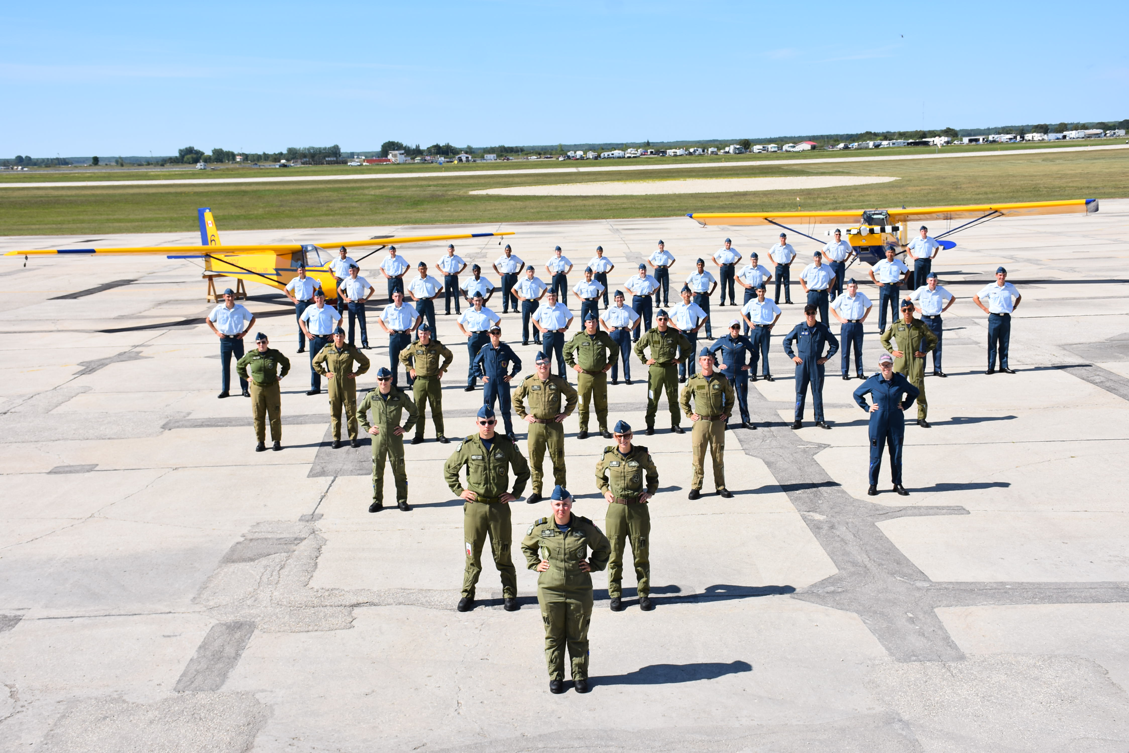
Summer Courses
23 Cadet Summer Training Centres across Canada
Places like Whitehorse, Yukon, and St. Jean, Quebec
Two types of summer courses
Regional – cadet in the first few years will go to these courses
National – more advanced courses for more senior cadets, along with a more competitive application process (written narrative, Commanding Officer recommendation letter, board interview, and written exams for pilot scholarships)
Summer Courses cover: Drill & Ceremonial, Aviation, Fitness & Sports, Survival, Military Band, Aerospace, Technology, Marksmanship, and International Exchange

Slide 21
Famous Air Cadets
Chris Hadfield – Astronaut (First Canadian International Space Station Commander & First Canadian to walk in space)
Marc Garneau – First Canadian astronaut
Maryse Carmichael – First female snowbirds pilot and then commander
Gordon Barnhart - Lieutenant Governor of Saskatchewan
Jim Carrey - Actor
Regan Wickett - Former snowbirds pilot (former cadet at 107 Spitfire Squadron in Saskatoon)
Ray Hnatyshyn - former Governor General of Canada (former cadet at 107 Spitfire Squadron in Saskatoon)

Slide 22
Find us online
Website: www.SKACL.ca
Facebook: Air Cadet League of Canada – Saskatchewan Provincial Committee

